Slide 1

Laser Turret
Developed By
Adnan Amir
Aaryaman Chandgothia
Under the Guidance of
Prof. Dattatray Sawant
Sem : VIII Subject : VI
B Tech Mechatronics
Academic Year : 2022 -2023

Slide 2
Introduction
This project is meant to be used as a remote defense turret for military applications
Currently used turret applications require an operator to be present in the turret while controlling it
This often means that the operator loses their life upon destruction of the turret
Using LabVIEW we can design a turret that need not require an operator to mount it
Instead the operator can control the turret from a remote location
It can allow the operator to aim using the onboard camera and fire using a virtual button

Slide 3
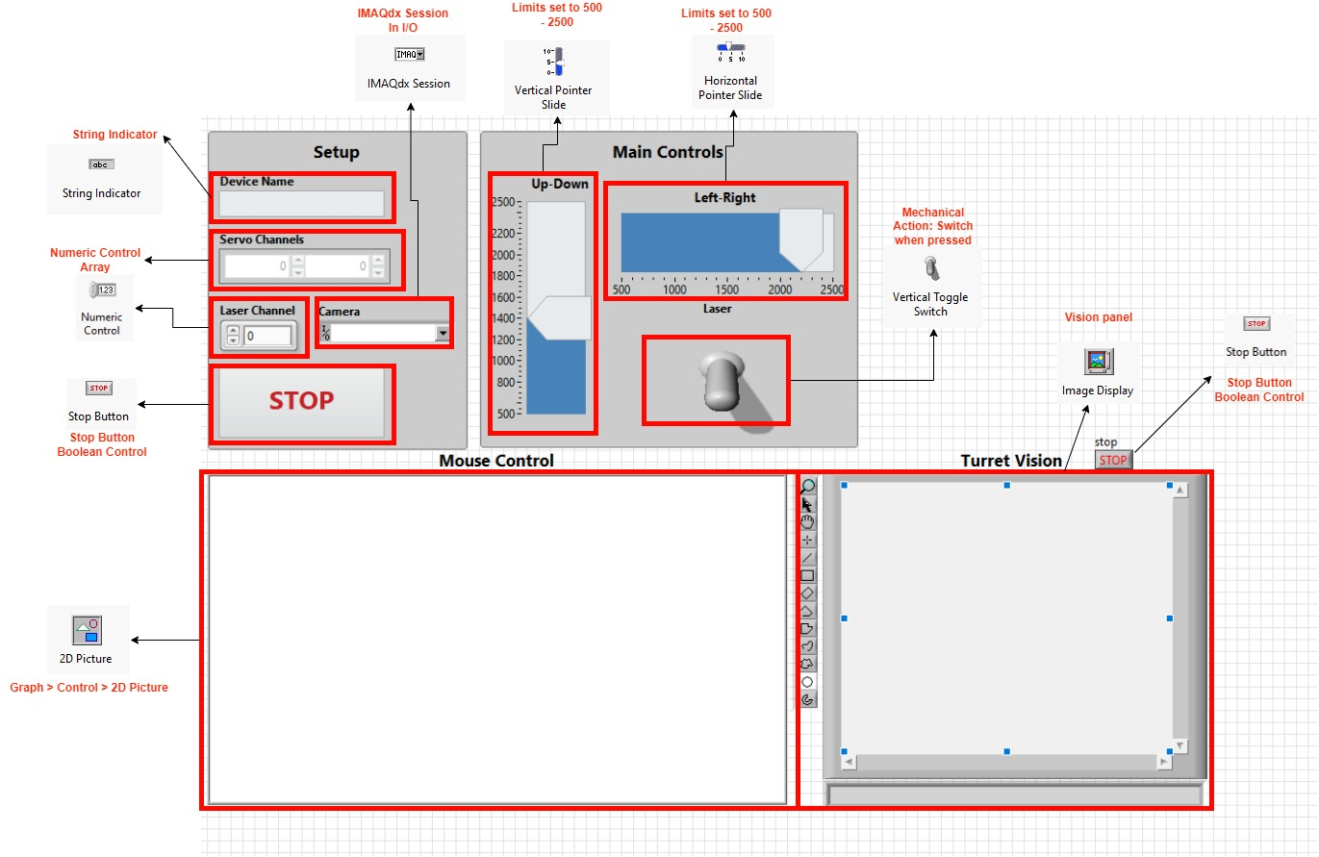
VI’s used in Front Panel

Slide 4
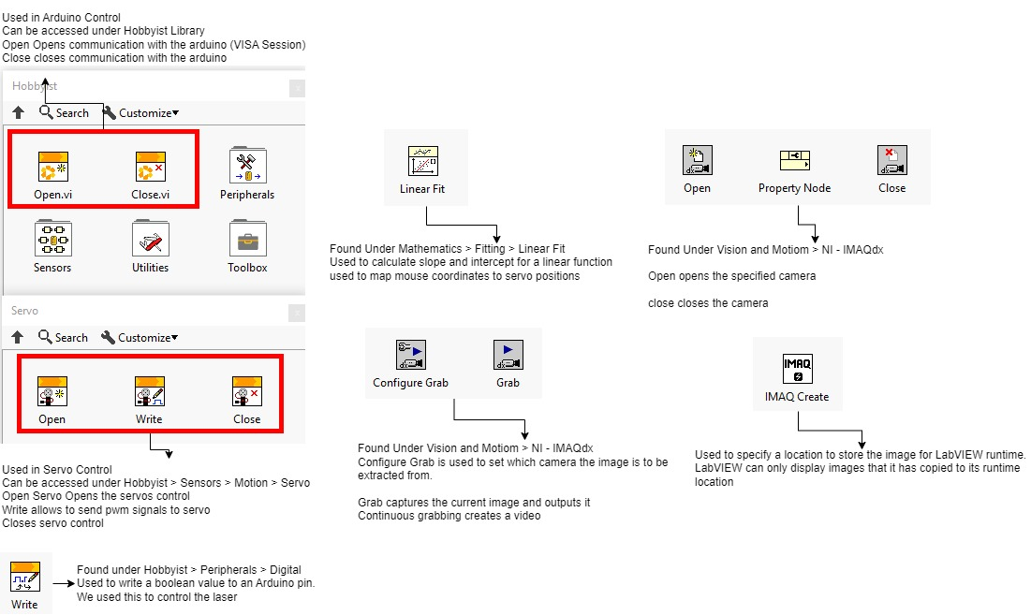
VI’s used in Block Diagram

Slide 5
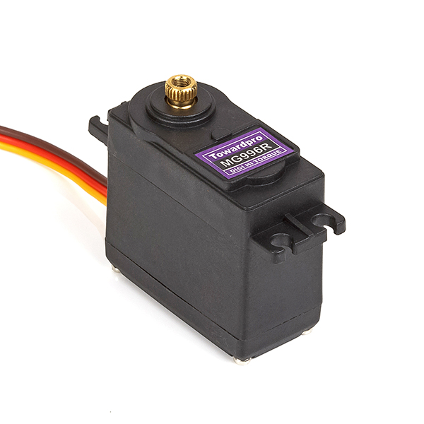
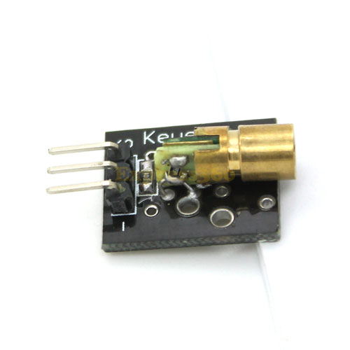

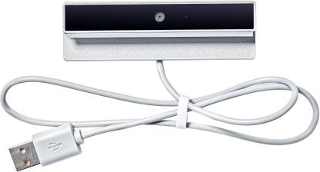
Components used in Hardware
2x MG996R Servos
KY – 008 Laser Module
Arduino Uno R3
MI USB Web Camera

Slide 6
THANK YOU

